Slide 1
Data Analytics
Chapter 1
Data Analytics Overview

Slide 2
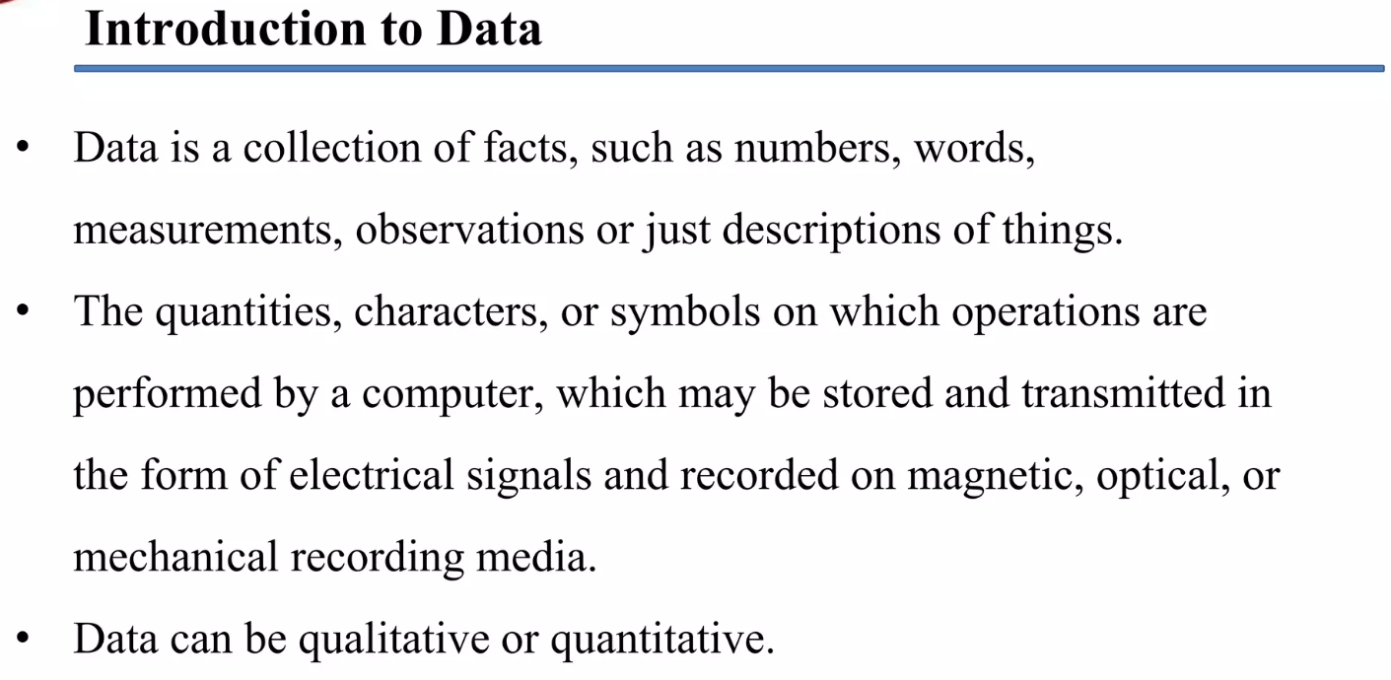

Slide 3
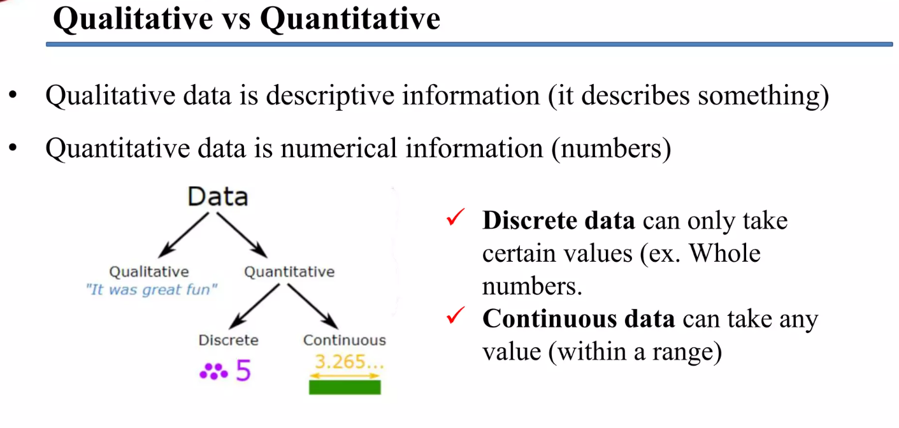

Slide 4
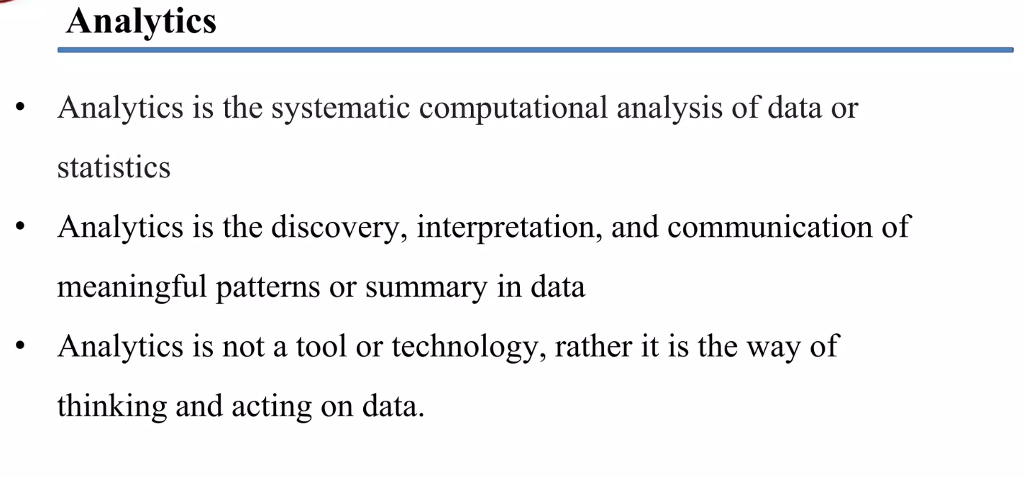

Slide 5
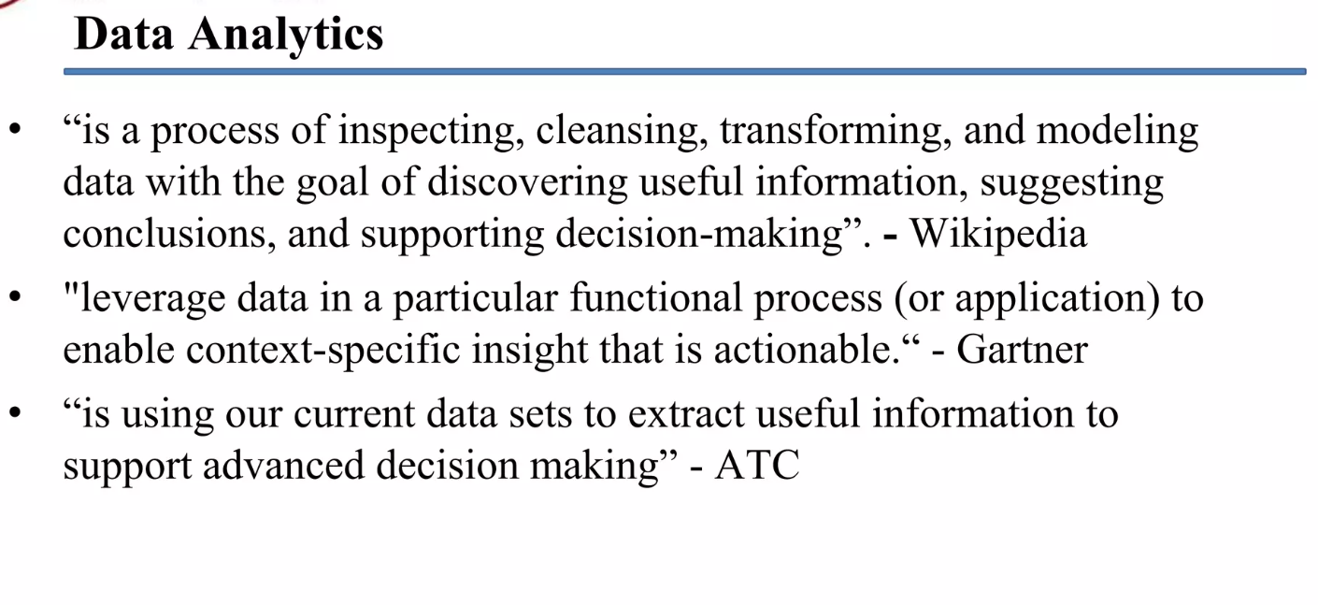

Slide 6
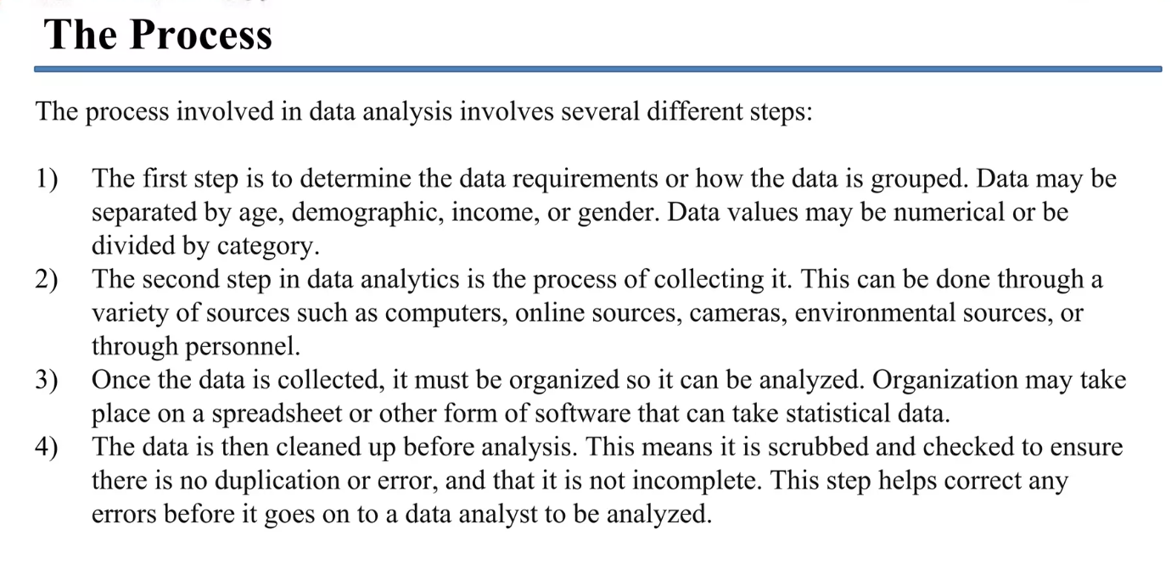

Slide 7
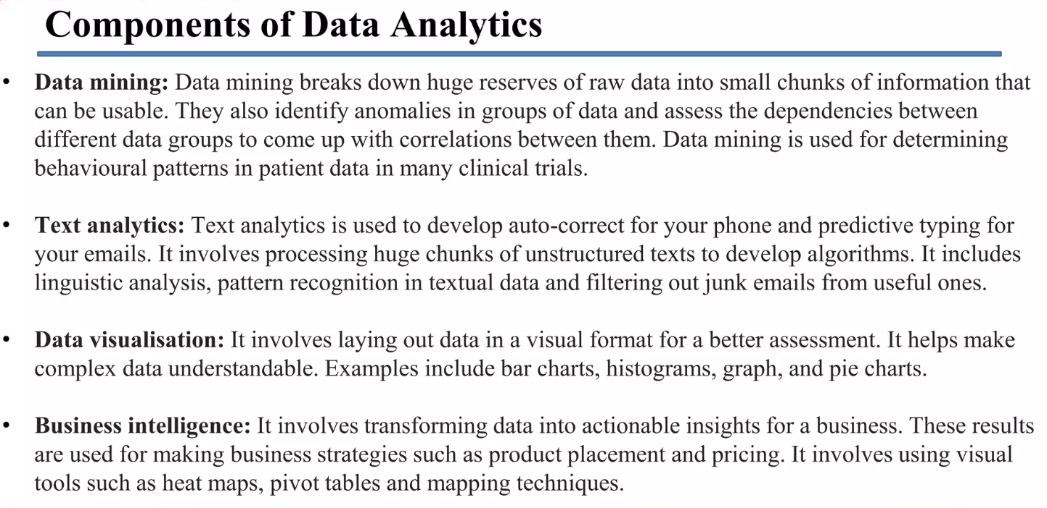

Slide 8
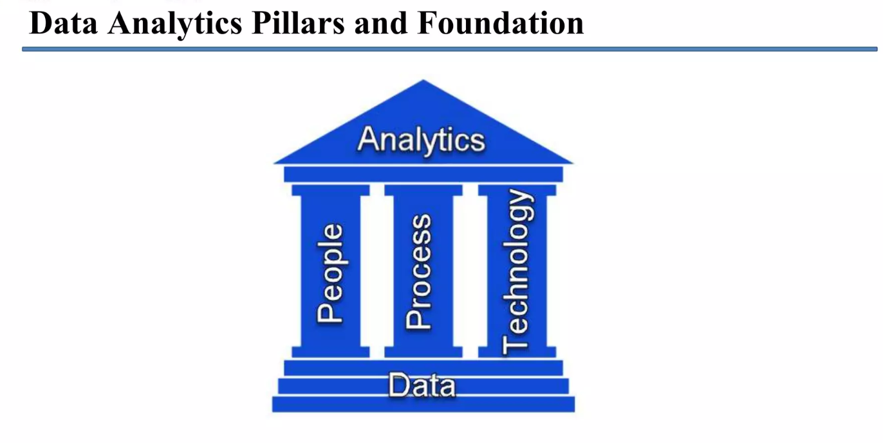

Slide 9
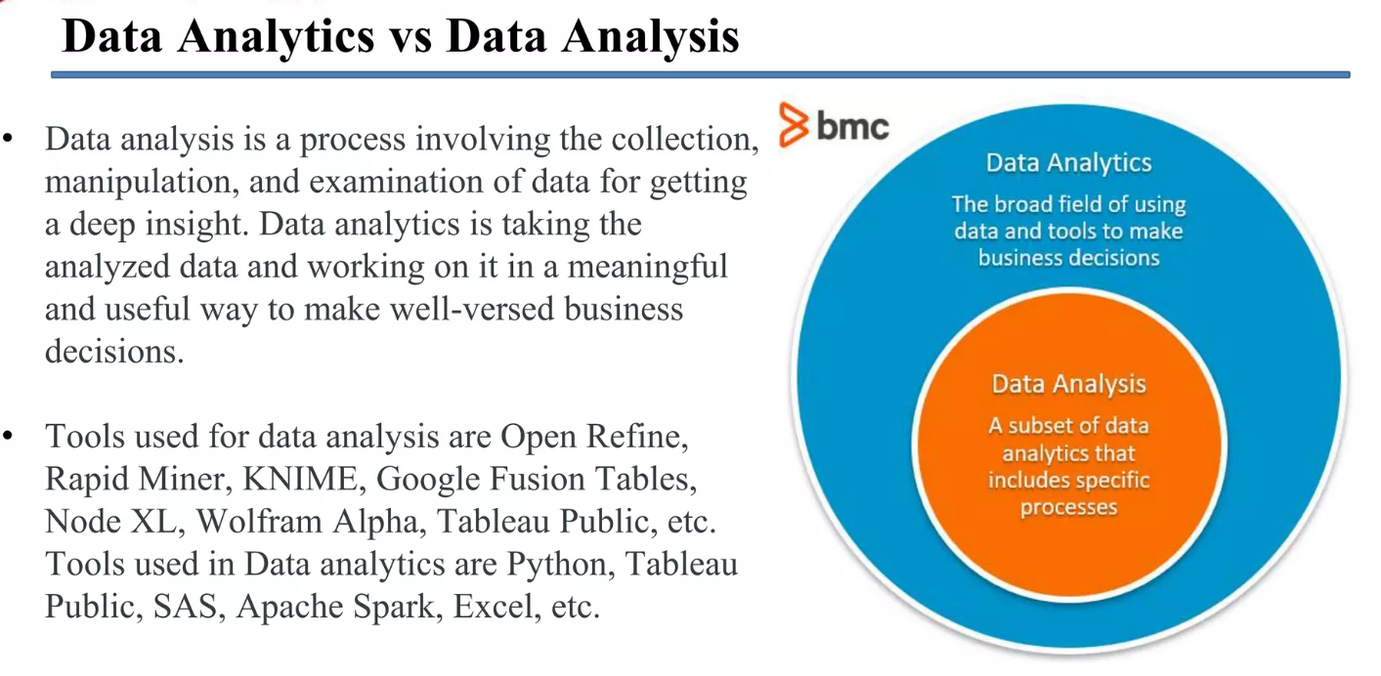

Slide 10
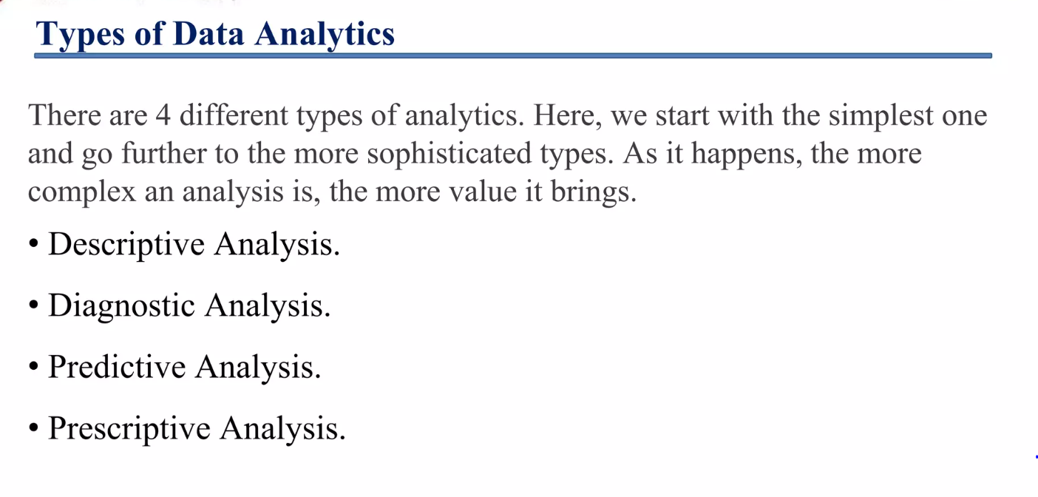

Slide 11
Types of Data Analytics
There are four major types of data analytics:
Predictive (forecasting)
Descriptive (business intelligence and data mining)
Prescriptive (optimization and simulation)
Diagnostic analytics

Slide 12
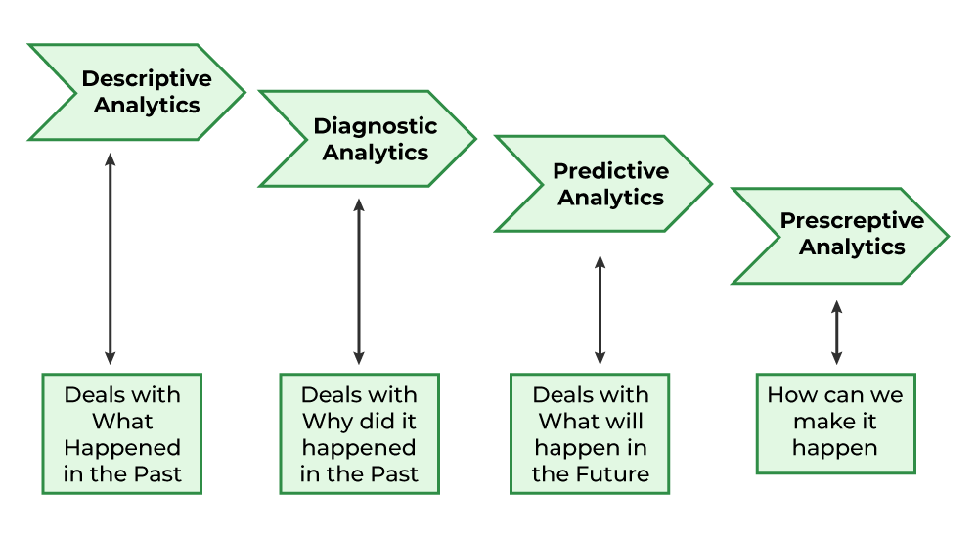
Types of Data Analytics

Slide 13
Predictive Analysis
Predictive analytics turn the data into valuable, actionable information. predictive analytics uses data to determine the probable outcome of an event or a likelihood of a situation occurring. Predictive analytics holds a variety of statistical techniques from modeling, machine learning, data mining, and game theory that analyze current and historical facts to make predictions about a future event. Techniques that are used for predictive analytics are:
Linear Regression
Time Series Analysis and Forecasting
Data Mining
Basic Cornerstones of Predictive Analytics
Predictive modeling
Decision Analysis and optimization
Transaction profiling

Slide 14
Example
For example, an advertising campaign for t-shirts on Facebook could apply predictive analytics to determine how closely conversion rate correlates with a target audience’s geographic area, income bracket, and interests. From there, predictive modeling could be used to analyze the statistics for two (or more) target audiences, and provide possible revenue values for each demographic.

Slide 15
Descriptive Analysis
Descriptive analytics looks at data and analyze past event for insight as to how to approach future events. It looks at past performance and understands the performance by mining historical data to understand the cause of success or failure in the past. Almost all management reporting such as sales, marketing, operations, and finance uses this type of analysis.
The descriptive model quantifies relationships in data in a way that is often used to classify customers or prospects into groups. Unlike a predictive model that focuses on predicting the behavior of a single customer, Descriptive analytics identifies many different relationships between customer and product.
Common examples of Descriptive analytics are company reports that provide historic reviews like:
Data Queries
Reports
Descriptive Statistics
Data dashboard

Slide 16
Example
Ad hoc reports, on the other hand, are designed by you and usually aren’t scheduled. They are generated when there is a need to answer a specific business question. These reports are useful for obtaining more in-depth information about a specific query. An ad hoc report could focus on your corporate social media profile, examining the types of people who’ve liked your page and other industry pages, as well as other engagement and demographic information. Its hyper specificity helps give a more complete picture of your social media audience. Chances are you won’t need to view this type of report a second time (unless there’s a major change to your audience).

Slide 17
Prescriptive Analysis
Prescriptive Analytics automatically synthesize big data, mathematical science, business rule, and machine learning to make a prediction and then suggests a decision option to take advantage of the prediction.
Prescriptive analytics goes beyond predicting future outcomes by also suggesting action benefits from the predictions and showing the decision maker the implication of each decision option. Prescriptive Analytics not only anticipates what will happen and when to happen but also why it will happen. Further, Prescriptive Analytics can suggest decision options on how to take advantage of a future opportunity or mitigate a future risk and illustrate the implication of each decision option.
For example, Prescriptive Analytics can benefit healthcare strategic planning by using analytics to leverage operational and usage data combined with data of external factors such as economic data, population demography, etc.

Slide 18
Example
Using advancements in ML, prescriptive analytics can help answer questions such as “What if we try this?” and “What is the best action?” You can test the correct variables and even suggest new variables that offer a higher chance of generating a positive outcome.

Slide 19
Diagnostic Analysis
In this analysis, we generally use historical data over other data to answer any question or for the solution of any problem. We try to find any dependency and pattern in the historical data of the particular problem.
For example, companies go for this analysis because it gives a great insight into a problem, and they also keep detailed information about their disposal otherwise data collection may turn out individual for every problem and it will be very time-consuming. Common techniques used for Diagnostic Analytics are:
Data discovery
Data mining
Correlations

Slide 20
Example
For example, a sales rep that closed significantly fewer deals one month. A drill down could show fewer workdays, due to a two-week vacation.
Discover and alerts notify of a potential issue before it occurs, for example, an alert about a lower amount of staff hours, which could result in a decrease in closed deals. You could also use diagnostic data analytics to “discover” information such as the most-qualified candidate for a new position at your company.

Slide 21
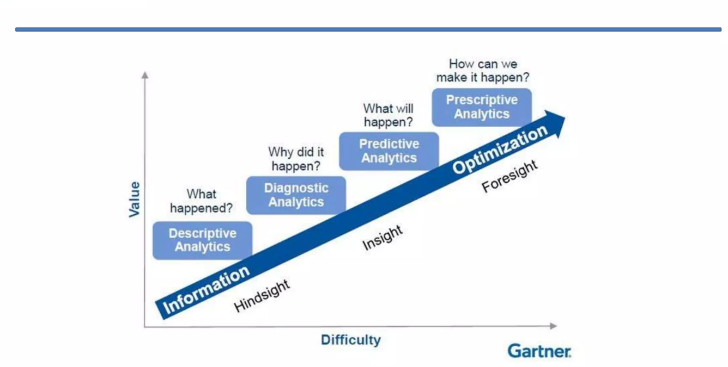

Slide 22
Benefits of Data Analytics
#1 Informed Decision Making
One of the most significant benefits of data analytics is that it takes speculation out of critical (and even minor) business decisions. Historical data provides valuable insight that enables businesses to assess where they presently stand, predict future outcomes, and pinpoint—and mitigate—risks.
#2. Operational Efficiency and Process Improvement
Enhanced productivity and efficiency enable businesses to keep pace with their competitors (if not outrun them) while also meeting the increasing customer demand for seamless and swift experiences. Data collection and data analytics can help a company up level their processes and improve their overall efficiency by identifying ways to:
Curb manual labor (and the expenses that arrive with it)(curb means to control)
Spot bottlenecks in production
Streamline and strengthen workflows
Maximize supply chain operations

Slide 23
Benefits of DA
#3. Customer Understanding and Personalization
Understanding a customer’s behavior—from what they buy to when they buy—is essential to boosting customer retention and a brand’s bottom line. Companies can cultivate stronger relationships with their patrons by anticipating the products and services they want and need through a combination of analyzing:
Behavioral data
Demographic data(information of groups according to certain attributes)
Psychographic data(personality, values,attitudes,lifestyle)
Transactional data
We all know how refreshing and reassuring it feels when a company seems to “get” you (and a product or service pops into view at precisely the right moment). This is often thanks to strong data analytics and business intelligence.

Slide 24
Benefits of DA
#4. Marketing and Sales Optimization
It’s safe to say that no business exists that isn’t intent on bolstering(to encourage) their sales performance.
Data analytics and business intelligence can help substantially in this regard. In fact, companies that utilize data-driven marketing tactics have a five times higher ROI than businesses that don’t.
Specifically, data analytics facilitates:
Improved marketing messages that may resonate with new and existing customers
A clearer comprehension of which keywords fuel traffic and lead to conversions
Elevated content decisions based on a target audience’s preferences and engagement
Data analytics can also help companies track which products and services are performing well and predict sales trends—and leverage this qualitative data in their product management, development, and marketing strategies with the help of data visualization tools.

Slide 25
Benefits of DA
#5. Competitor Analysis and Market Research
Businesses must comprehensively understand their market’s landscape—and stay apprised(informed) of changes to adjust and revamp(to change something) when necessary.⁷
Data analytics helps companies evaluate their competitors’ performance, price points, marketing methods, social media reach, and more. Business leaders can make informed decisions to ensure they’re taking the proper, proactive steps to remain at the top of their position.

Slide 26
Additional Benefits of Data Analytics
Data analytics is an invaluable tool for businesses. In addition to the benefits outlined above, it may enhance:
Financial performance and budgeting – Data analytics offers an evidence-based, holistic view of how a company is performing—and where there’s room for improvement. Payroll costs, revenues, and net income—can all be analysed to craft a sustainable budget and maximize profits.
Fraud detection and security – Fraud data analytics (a subset of data analytics) assesses information to detect suspicious activity, anticipate risks, minimize vulnerability, and protect businesses and their customers.
Last but certainly not least, data analytics can help businesses forecast trends and opportunities—and strategically plan how to position themselves in the future.

Slide 27
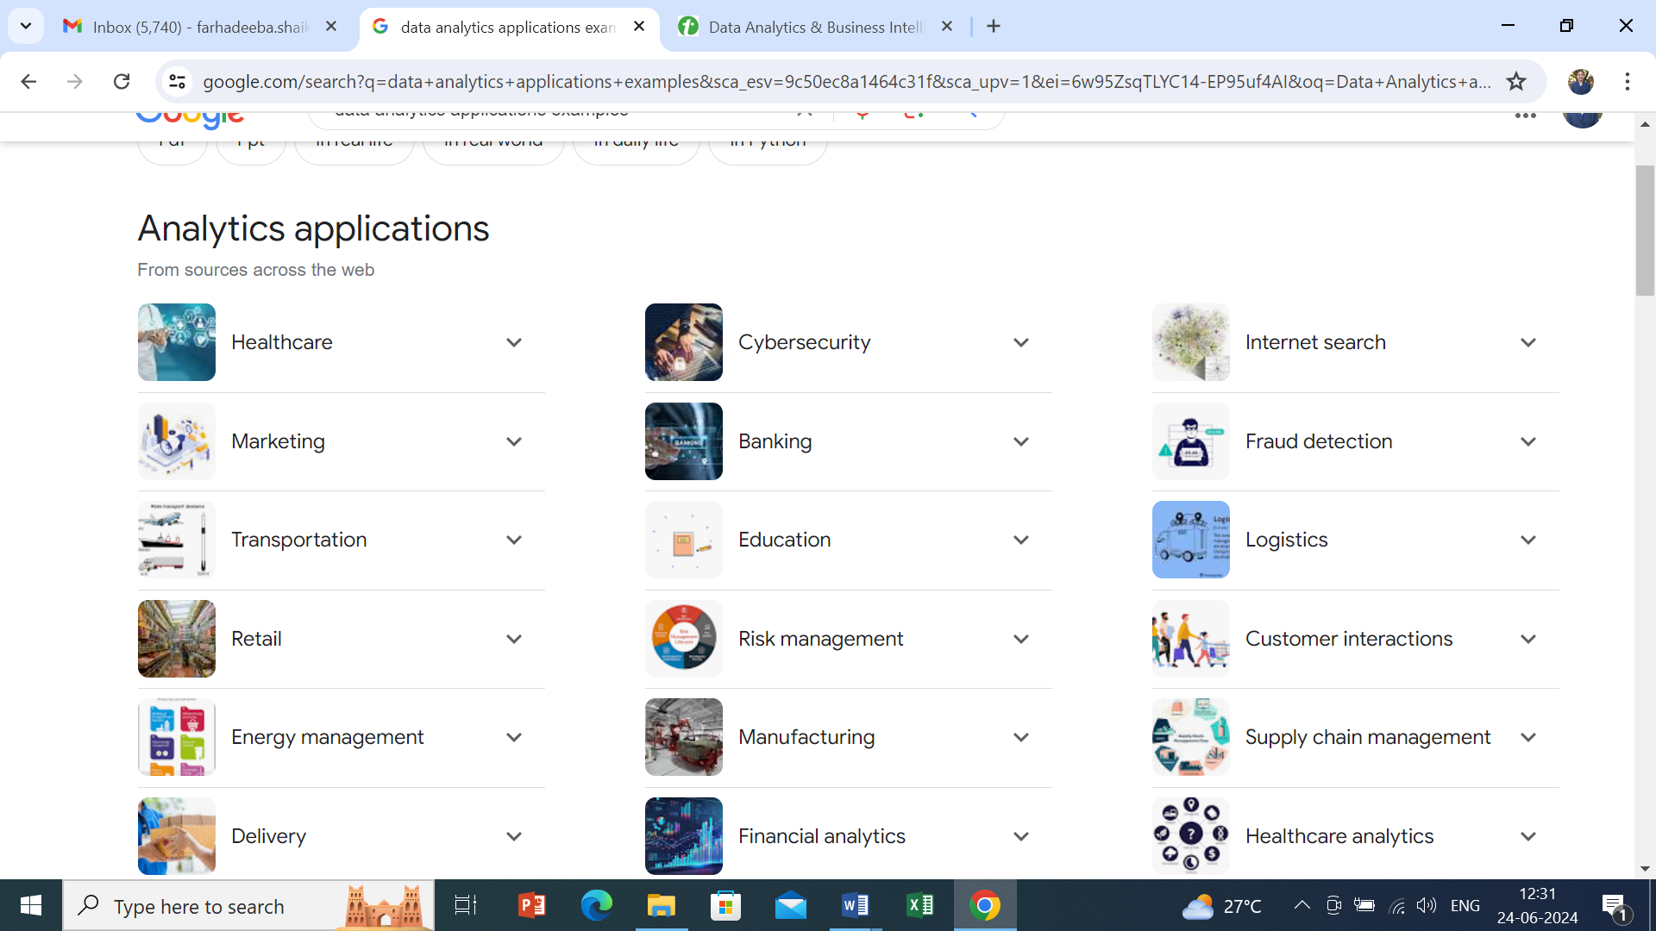
Applications of DA

Slide 28
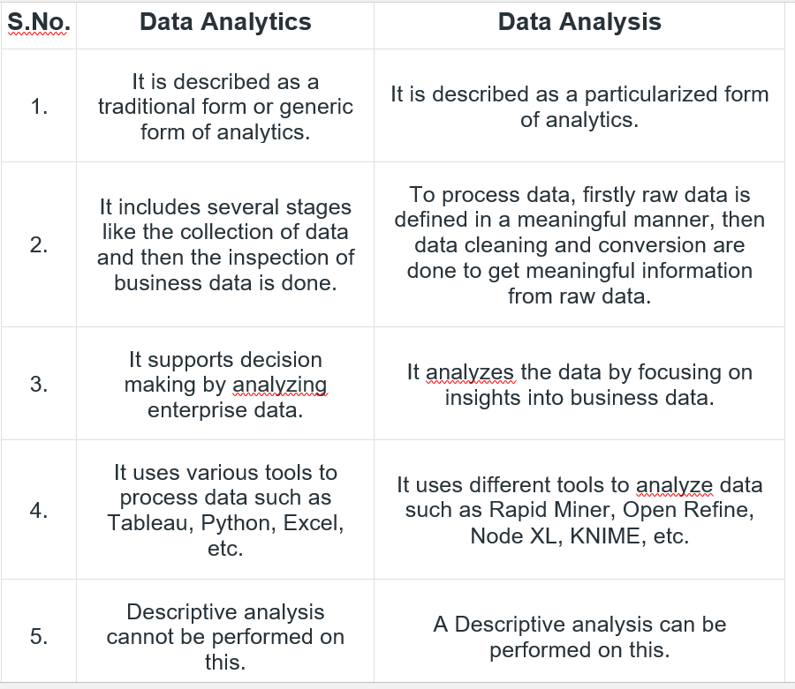

Slide 29
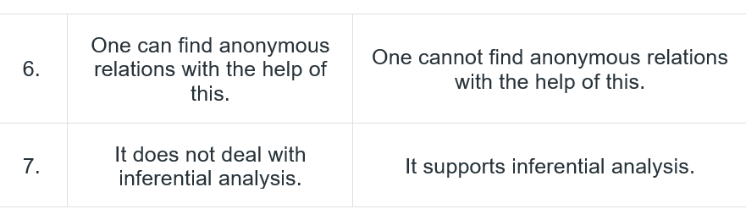

Slide 30
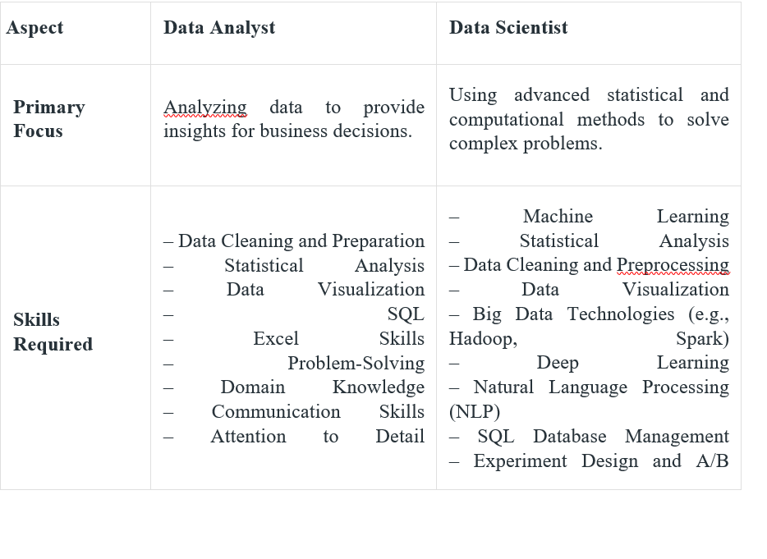

Slide 31
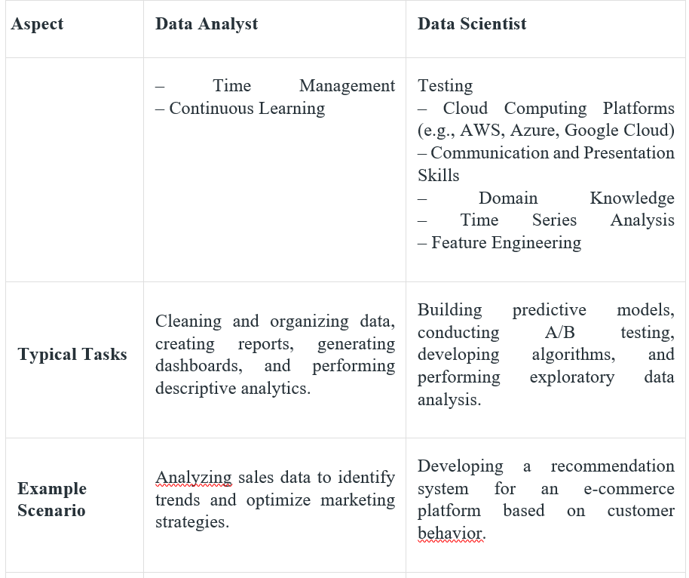

Slide 32
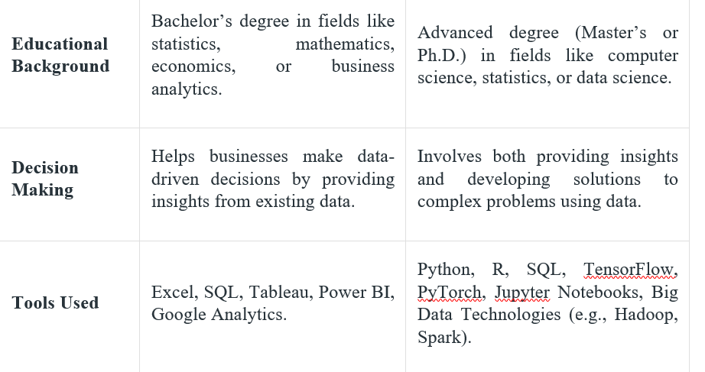

Slide 33
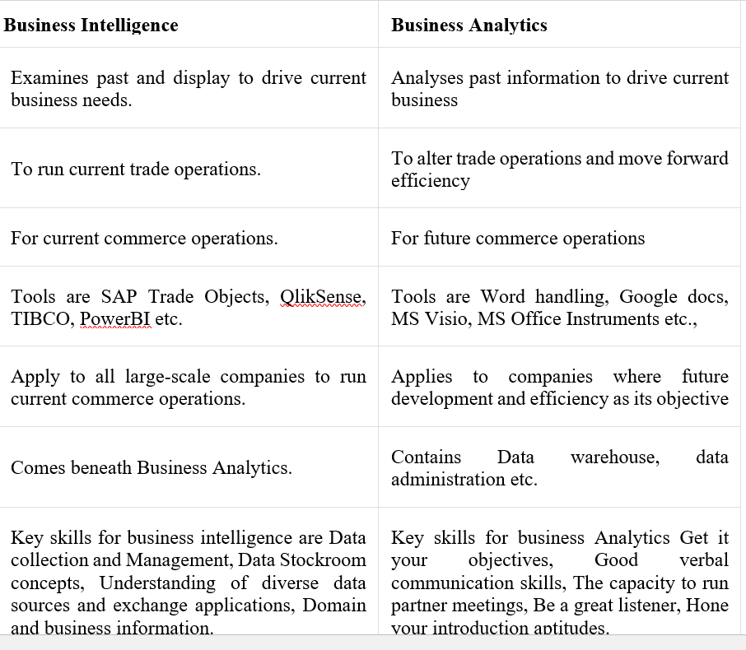

Slide 34
The Roles and Responsibilities of a Data Analyst
Data analysts are responsible for collecting and analyzing data to provide valuable insights.
They manage databases, troubleshoot issues, and optimize performance.
Data analysts generate reports and present findings to aid decision-making.
Specialized tasks include data visualization, statistical analysis, and predictive modeling.
Key skills include technical proficiency, analytical thinking, communication, and collaboration.

Slide 35
Core Responsibilities of Data Analyst
Data Collection and Analysis
At the heart of a data analyst's duties is data collection and examination. This involves gathering relevant information from multiple sources, structuring it in a way that allows for effective analysis, and then scrutinizing it to derive meaningful insights.
Depending on the nature of the data and the objectives of the analysis, this process may demand a range of techniques, from simple queries to complex statistical methods.
Database Management and Maintenance
Maintaining and managing databases is another essential duty of a data analyst. They create and manage databases to store and organize data effectively.
Additionally, they are responsible for ensuring data integrity, troubleshooting any issues, and implementing necessary updates or modifications to optimize database performance.

Slide 36
Core Responsibilities of Data Analyst
Generating Reports and Presenting Findings
Turning data into actionable insights is a critical role for data analysts. After analyzing data, they generate comprehensive reports highlighting key findings and trends.
However, compiling and presenting these insights in a way that's understandable and valuable to management and other stakeholders is an art in itself. A successful data analyst is able not only to produce quality analysis but also to communicate its implications effectively to aid decision-making.
Specialized Roles and Tasks
Certain data analyst positions may involve specialized tasks. As businesses evolve and data analysis becomes more integrated into decision-making processes, data analysts are increasingly required to wear multiple hats and delve(search for something) into specialized realms(an area of activity).

Slide 37
Core Responsibilities of Data Analyst
Data Visualization and Dashboard Creation
Data-driven decisions are vital to the success of a business, and the ability to visualize data and create dashboards is becoming a definitive skill for data analysts.
These tasks go beyond presenting data in charts or tables. They involve creating a visual narrative that conveys complex insights in a simplified, easily digestible manner.
This can be achieved through various tools and software that allow an analyst to build interactive dashboards, maps, and other graphical representations, allowing the data to 'tell the story' itself.

Slide 38
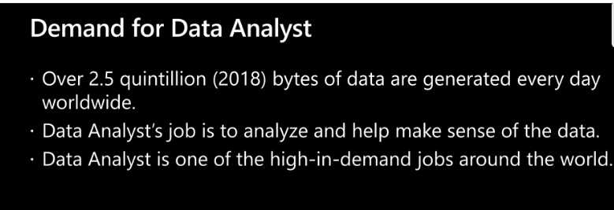

Slide 39


Slide 40
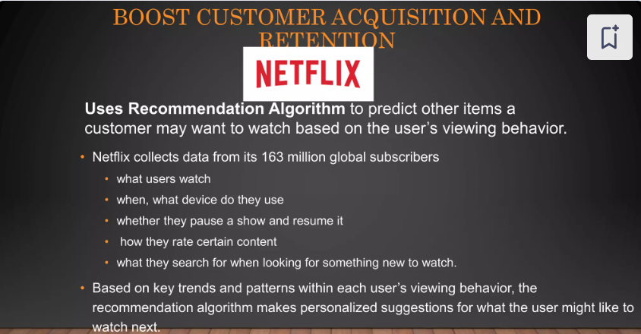

Slide 41


Slide 42
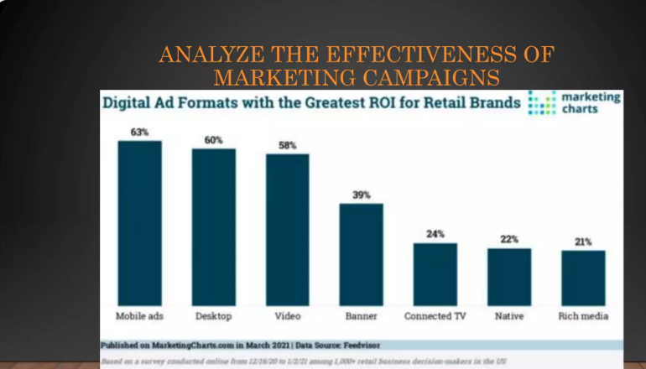

Slide 43
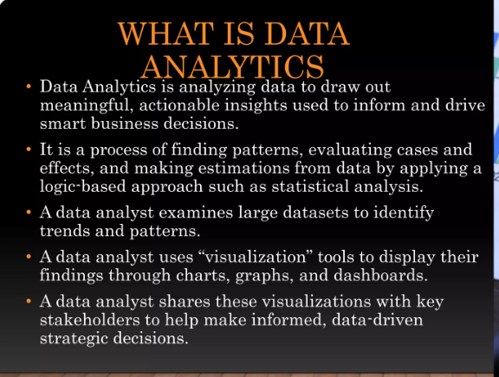

Slide 44
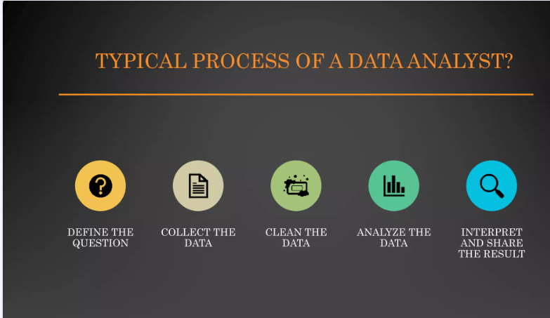

Slide 45
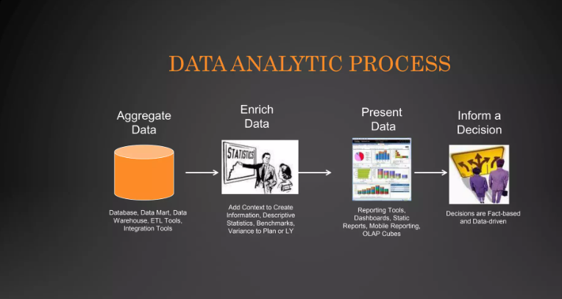

Slide 46


Slide 47


Slide 48
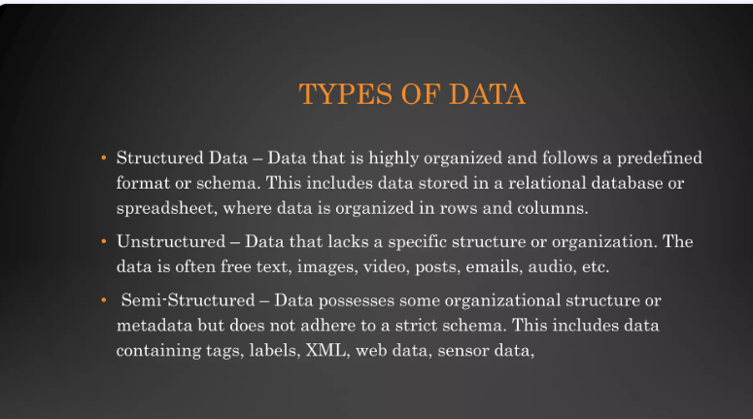

Slide 49
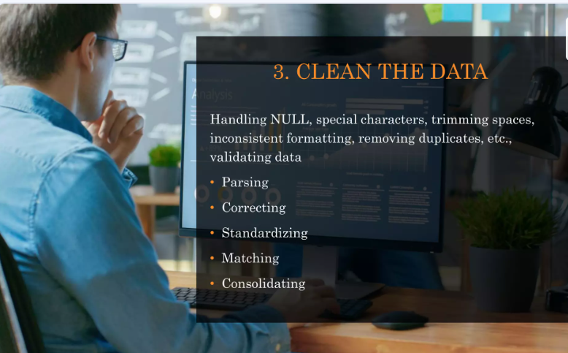

Slide 50
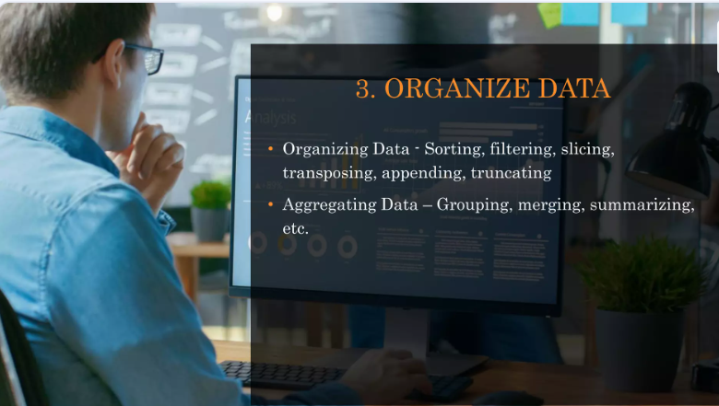

Slide 51
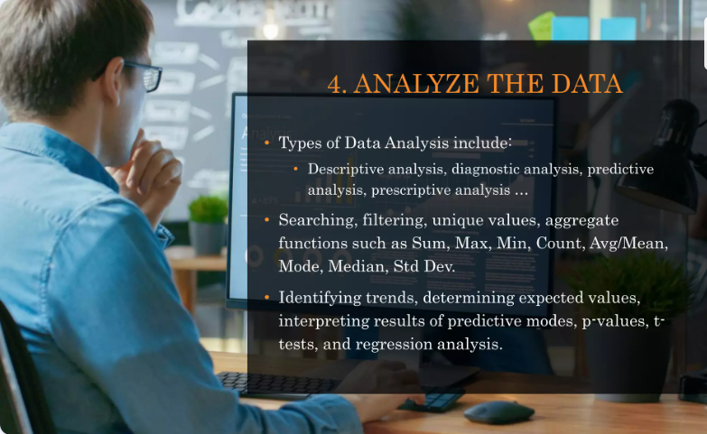

Slide 52
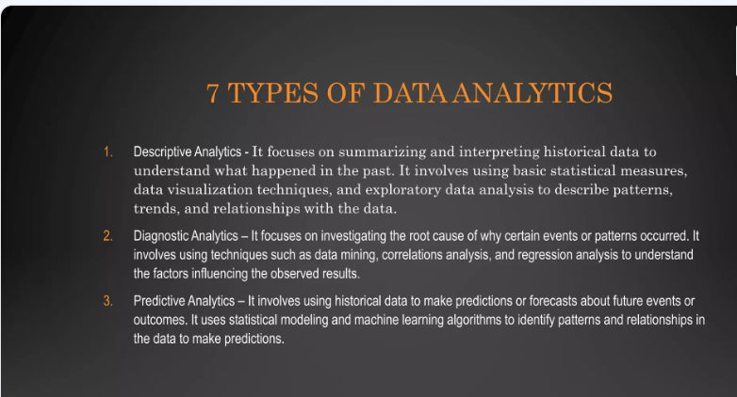

Slide 53
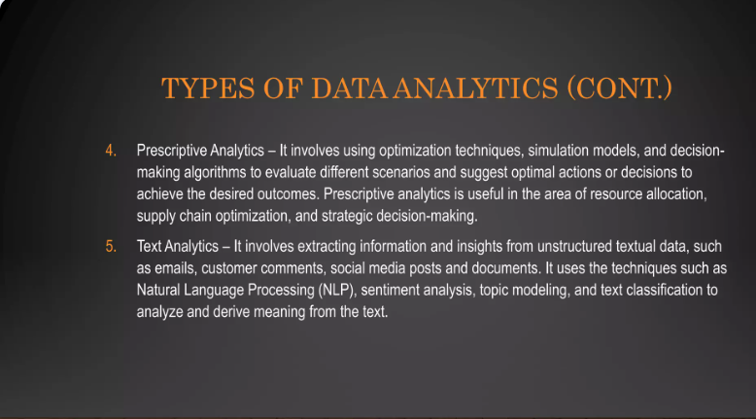

Slide 54
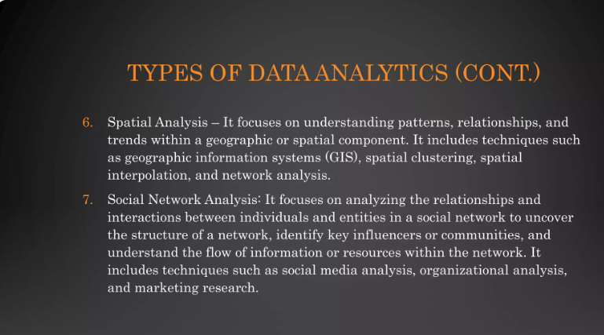

Slide 55
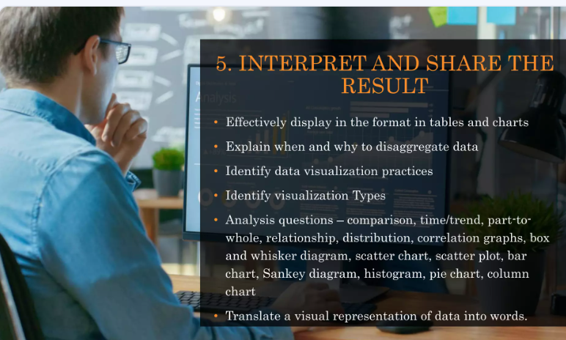

Slide 56
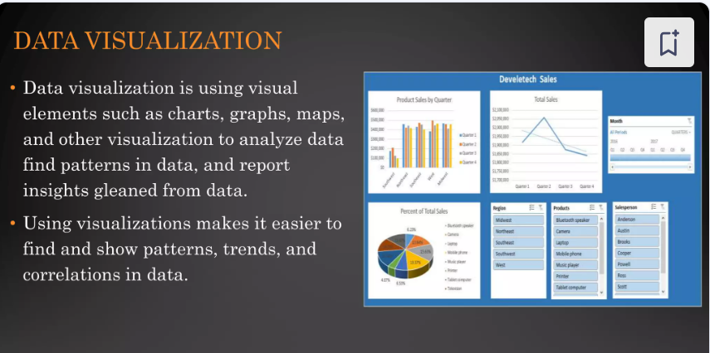

Slide 57
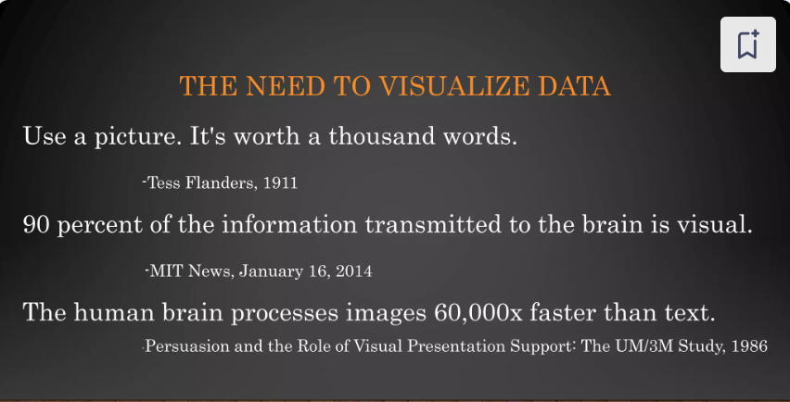

Slide 58
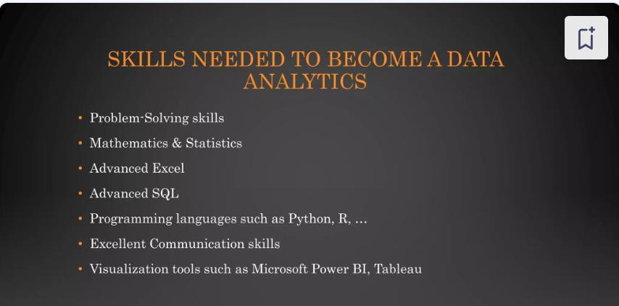

Slide 59
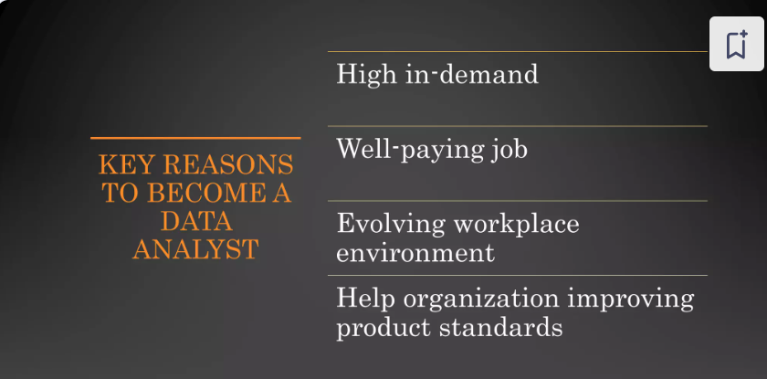

Slide 60
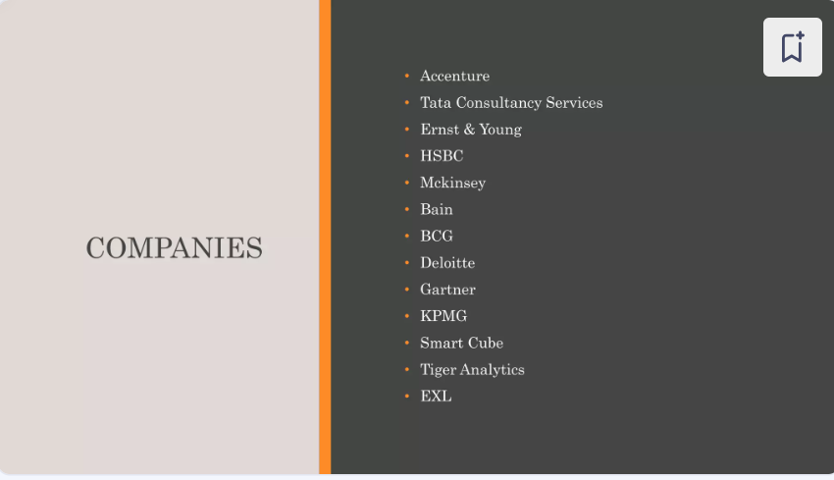

Slide 61
Roles and Responsibilities
Use data analysis tools for data extraction from various data sources.
Remove wrong or corrupt data.
Perform quality analysis tests on data.
Manage and develop databases.
Create database processes and systems to manage data.
Filter existing data based on the requirements of various stakeholders.
Use statistical tools and data analysis to predict market trends and share actionable insights.
Prepare detailed reports based on analysed data to forecast predictions and trends.
Work with various members of the team to stay updated on data management systems and processes. This includes the technical, operations, product and engineering teams.
Manage Exploratory Data Analysis projects and identify patterns.
Understand MS Excel thoroughly along with Macros and VBA.
Be proficient in statistical tools such as SAS and SPSS along with various other tools depending on project needs.

Slide 62
Roles and Responsibilities of Data Analyst
Gather data from primary and secondary sources, ensuring the upkeep of databases and data systems.
Detect, examine, and decode trends or patterns within intricate datasets.
Cleanse data and scrutinize computer-generated reports and outputs to identify and rectify coding errors.
Coordinate with management to align business and informational priorities.
Identify opportunities for process enhancements.
Employ statistical techniques to scrutinize data and produce actionable business insights.
Collaborate with the management team to determine and rank the needs of different business units.
Develop data dashboards, charts, and visual aids to support decision-making across departments.
Convey insights through both reports and visual presentations.
Partner with engineering and product development teams to understand business requirements.
Engage with managers from various departments to specify data requirements for analysis projects tailored to their unique business processes.
Partner with engineering and product development teams to understand business requirements.
Engage with managers from various departments to specify data requirements for analysis projects tailored to their unique business processes.

Slide 63
Skills and Qualifications
Possess a solid foundation in statistics and practical experience with statistical software (such as Excel, SPSS, SAS) and mastery in data analysis languages including SQL, Python, and R.
Exhibit exceptional analytical abilities to compile, structure, examine, and present substantial data sets with precision and thoroughness.
Capable of critically evaluating data to derive meaningful, actionable insights.
Demonstrate superior communication and presentation capabilities, adept at simplifying complex data insights for audiences without a technical background.
A bachelor's degree in Computer Science, Information Management, Statistics, or a comparable discipline is required, with prior experience in data analysis or a related field being advantageous.
Adept at report writing and presenting findings.
Ability to work under pressure and meet tight deadlines.
A deep understanding of the industry and business operations is a plus.

Slide 64
Key Skills a Data Analyst Should Have:
Collecting, measuring, organising and analysing data requires strong mathematical skills
Understanding of SQL, R, Oracle, Python and other programming languages
Technical experience working with data models, database design development, segmentation and data mining techniques
Experience with reporting package handling, including databases, business objects and programming (XML, ETL or JavaScript frameworks)
In-depth understanding of statistical packages and statistics used to analyse datasets.
Fluent with the workings of platforms for data processing, such as Apache Spark and Hadoop
Data visualisation software knowledge including Qlik and Tableau
Knowing how to apply and create accurate algorithms for datasets to identify solutions
Problem-solving capabilities
Attention to fine details
Solid understanding of report writing, making presentations and querying
Ability to work in a team
Strong written and verbal communication skills
Industry experience specific to data analysis

Slide 65
Qualifications of a Data Analyst:
To become a successful data analyst, technical experience alone is not enough. Earlier, requirements included an undergraduate degree in an analytical or statistical subject like statistics, mathematics or economics. Even today, students with this background have an edge over the competition. Alternatively, you could also choose a postgraduate degree or a skill-based certification. Skill-based certifications have become immensely popular these days as they cover all data analyst roles and responsibilities.
In addition to your technical skills, you also need soft skills like:
Critical thinking capabilities
Presentation and communication skills
Using a logical and systematic approach to solve problems
Team skills
Creativity

Slide 66
Questions
Write any ten roles and responsibilities of Data Analyst
Write any ten tools do Data Analyst use with its purpose.
Write any five importance of data analyst in today’s data driven world.
Write in detail data Analyst Qualifications required mentioning educational, technical and soft skills.
Write any 20 essential data analyst skills required.

Slide 67
Thank u

